Slide 1

Contract Monthly Claim System (CMCS)
Automation of Lecturer Claims, Approvals, and HR Reports
Name: Rahil Ramdass
Student Number: ST10434494
Module: Programming 2b

Slide 2
System Overview
A web-based system built with ASP.NET Core MVC
Automates lecturer claims, coordinator approvals, and HR reporting
Improves accuracy, reduces manual effort, and ensures compliance

Slide 3
Project Objectives
Simplify claim submissions for lecturers
Streamline approval workflows for coordinators and managers
Automate HR reporting and payroll support
Ensure system reliability, scalability, and security

Slide 4
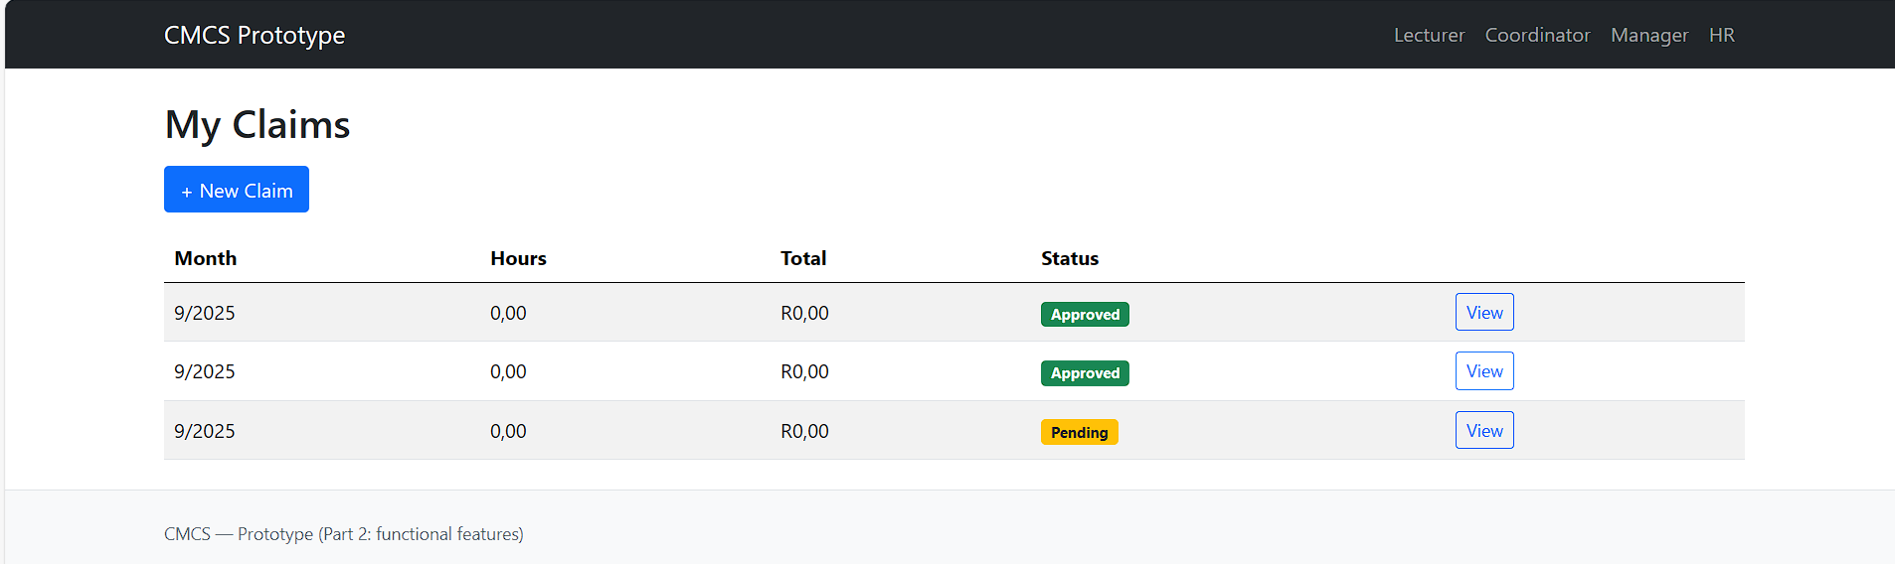
Lecturer View (Automation)
Screenshot of the Lecturer claim form in your app.
Show Hours Worked + Hourly Rate fields.
Show auto-calculated Total Amount updating (e.g., when you type hours/rate).

Slide 5
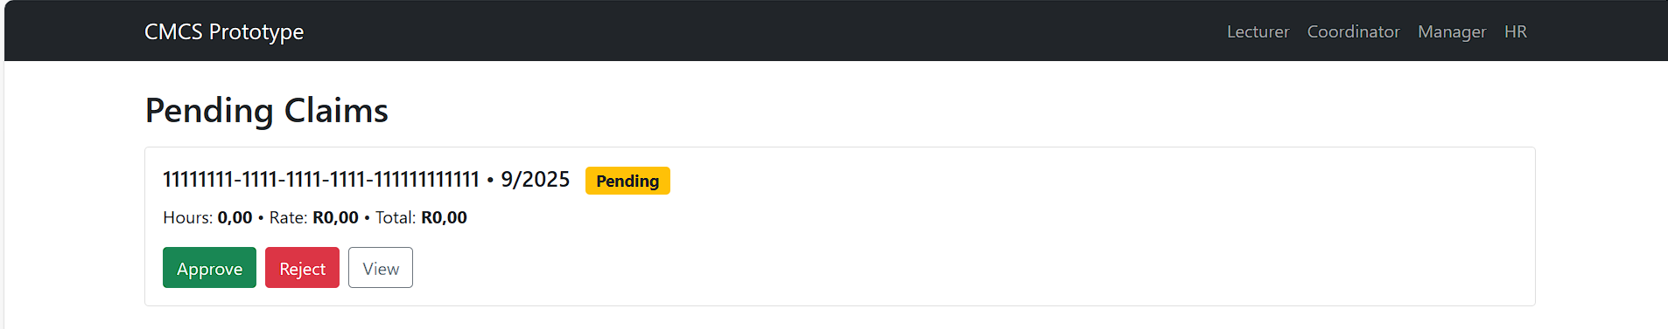
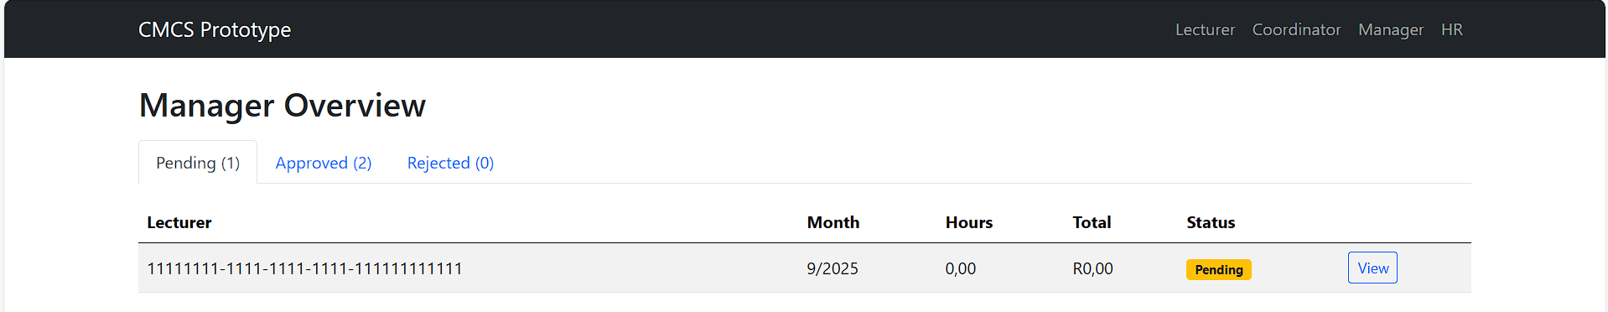
Coordinator/Manager View (Workflow)
View pending claims in dashboard
Approve or Reject with one click
Automated validation against business rules (hours, rates)
Status updates instantly (Pending → Approved/Rejected)
Screenshot → Pending claims dashboard

Slide 6
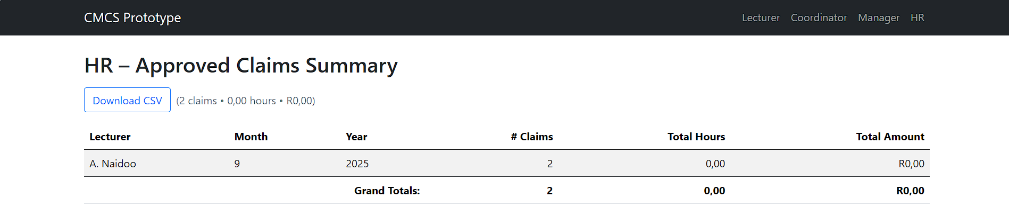
HR View (Reports)
Manage lecturer details in one interface
Auto-generated summary of approved claims
Exportable reports (CSV/Invoice-style summaries)

Slide 7
Benefits of Automation
Saves time for lecturers, coordinators, and HR
Reduces manual errors in calculations and reporting
Provides real-time visibility of claims
Standardises workflows across the institution

Slide 8
Technical Stack
Frontend: ASP.NET Core MVC, Bootstrap, jQuery
Backend: Entity Framework Core, ASP.NET Identity, Web API
Database: Azure SQL Database
Hosting: Azure App Service

Slide 9
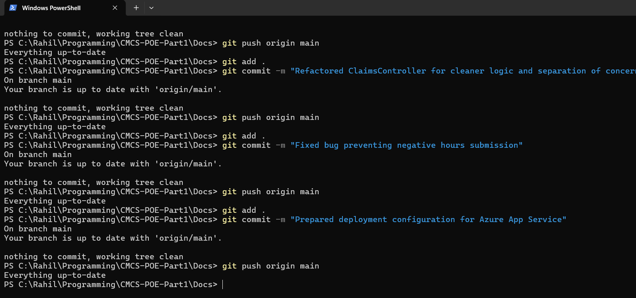
Version Control (GitHub)
10 commits with clear messages
Iterative development and testing
Example commits:
“Added auto-calculation feature for Lecturer claims”
“Implemented Coordinator approval workflow”
“HR report generation with LINQ queries”
Screenshot → GitHub commit history

Slide 10
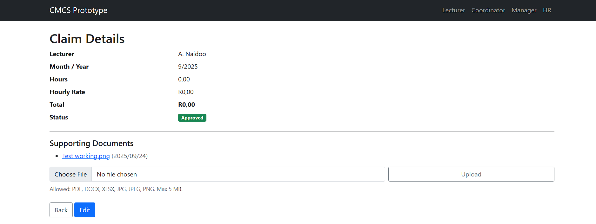
Lecturer Feedback Implementation
Feedback: Needed simpler inputs and clearer claim statuses
Enhancements made:
Auto-calculation for accuracy
Coloured badges for claim statuses
Document upload restrictions

Slide 11
Conclusion
CMCS demonstrates:
Automation of academic claim processes
Secure role-based workflows
Reliable HR reporting
Future enhancements: PDF invoice exports, email notifications, mobile access

